Slide 1
Azure Data Services
Abdul Rasheed Feroz Khan
Microsoft MVP – Azure
Microsoft Certified Trainer

Slide 2

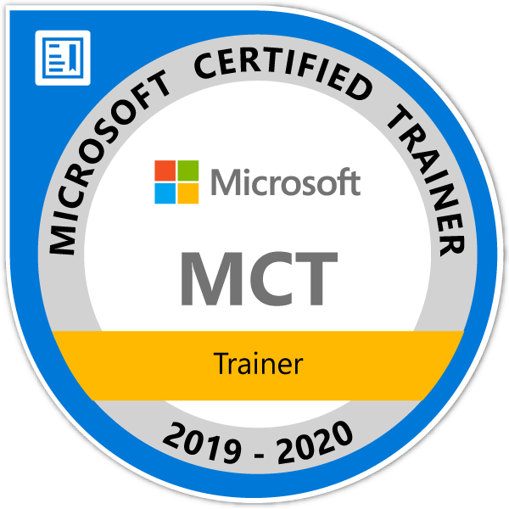
About me
Founder & Director – CodeSizzler
Microsoft Most Valuable Professional – Azure
Microsoft Certified Trainer
8 years of experience as Cloud Consultant
Azure – AWS – GCP – IoT – Machine Learning – Cognitive Services – Bot – Xamarin – Big Data
Consultant for Accenture, Adobe, Boeing, Deloitte., Infosys, Johnson Controls, Microsoft, Wipro, etc.,
Twitter - @TechFero
Email ID – feroz@codesizzler.info

Slide 3
Session Objective and Key Takeaway
Boost your knowledge & get prepared to gain skills on migrating workloads from On-Premise to Azure, backup and restore your data using Data Engineering services along with business implementation scenarios.

Slide 4
Hit Refresh
This will be a quick refresh session on Microsoft Azure covering the topics of Azure SQL Database, Storage Accounts, DMS, Stream Analytics, Event Hubs, Data Bricks, Azure Data Factory, Data Bricks, HDInsight, Cosmos DB and SQL Data Warehouse.

Slide 5
SQL Database an intelligent PaaS Service
Get a deep drive on Azure SQL Database & Managed Instances in Azure...
HOL:
Deploying Managed Instance for SQL Database
Implementing SQL Database on Azure VM
Azure SQL Single Database and SQL Elastic pools
Data Replication in SQL Database
Configuring SQL Data Sync
BCDR on Azure SQL Database
Implementing Azure AD Authentication for Database

Slide 6
Azure Data Migration
Ensure your knowledge on various services in migration components of Azure..
HOL:
Database Migration from On-Premises to Azure
Online Database Migration
Offline Database Migration
Performing Migration Trouble-Shooting
White board discussions on Troubleshoot under Migration, Migration Closure & Sign-Off, Business Scenarios on Azure Data Migration.

Slide 7
Hit Refresh - SQL Database
An enterprise-grade database-as-a-service platform with easily accessible tier-1 capabilities

Slide 8
Microsoft SQL Platform Continuum
Hybrid Cloud
Shared Lower Cost
On Premises
Platform as a Service
SQL
SQL
SQL
Azure SQL Database Virtualized Databases
Infrastructure as a Service
SQL
SQL
SQL
SQL Server in Azure VM Virtualized Machines
Virtual
SQL
SQL
SQL
SQL Server Private Cloud Virtualized Machines + Appliances
Physical
SQL
SQL Server Physical Machines (raw iron)
Dedicated Higher Cost
Off Premises
Higher Administration
Lower Administration

Slide 9
Azure SQL Database
Relational database-as-a-service, fully managed by Microsoft
For cloud-designed apps when enterprise-grade features and near-zero administration are key
Elastic Scale and Performance
Business Continuity and Data Protection
Self-managed and Familiar
Predictable performance levels
Scale up/down & out/in
Dashboard views of DB metrics
Self-service restore
Disaster recovery
Compliance-enabled
Self-managed
Programmatic APIs
Familiar tools and language
Enterprise-grade database platform with cloud economics

Slide 10
Azure SQL Database Service Tiers
Basic
Standard
Premium
Intended Use
Light transactional loads
Go-to option for most business applications
High throughput and business-critical databases
Availability
99.99%*
Size
2 GB
250 GB
500 GB
Performance
•
••
•••
Business Continuity
•
••
•••
Incremental performance and features with easy upgrade and downgrade
*The 99.99% availability SLA does not apply to Web and Business editions, which continue to be supported at 99.9% availability.

Slide 11
Azure SQL Database
Elastic Scale and Performance
Business Continuity and Data Protection
Self-managed and Familiar
Predictable performance levels
Scale up/down & out/in
Dashboard views of DB metrics
Self-service restore
Disaster recovery
Compliance-enabled
Self-managed
Programmatic APIs
Familiar tools and language

Slide 12
Scalable Performance
Basic, Standard, and Premium provide increasing performance levels
Relative performance is expressed in database throughput units (DTUs)
DTU is a blended measure of CPU, read IO, write IO, and memory
Scale performance up/down via portal, APIs, PS, or T-SQL to reflect actual or anticipated demand
Database remains online while scaling
Hourly billing improves cost efficiency
P3
P2
P1
S2
S0
S1
B
DTUs
5
10
20
50
100
200
800
Performance is easily scaled up or down to meet changing workload and business needs

Slide 13
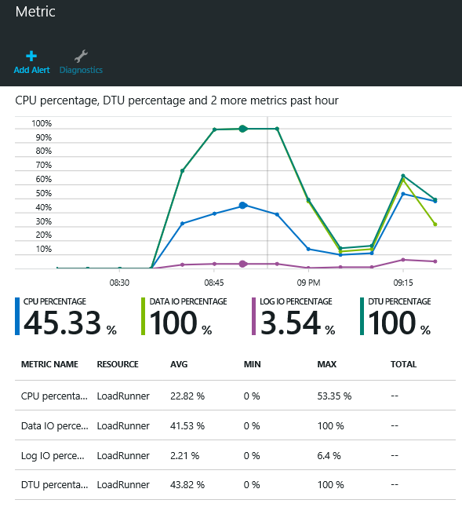
Rich Near-real-time Monitoring
Monitor resource consumption over time and set user-configurable alerts and notifications to guide scaling decisions
Rich metrics include % DTU usage, resource usage, database size, connection health
Dashboard views in the portal, or via APIs and DMVs
In-depth DMVs aid troubleshooting (e.g. at the query level)
Use monitoring and alerts to understand and manage resource utilization

Slide 14
Demo
Azure Management Portal
Database provisioning
Monitoring performance and scaling-up

Slide 15
Hit Refresh - DMS
Bringing cloud to your enterprise level of Databases…

Slide 16
Azure Database Migration Journey
Assess
Migrate
Optimize

Slide 17
Azure Database Migration Service
Fully managed PAAS
Designed to enable seamless migrations from multiple database sources to Azure
Provides assessment reports for migration

Slide 18
Azure Database Migration

Slide 19
Data Migration Assistant
Assesses on-premises SQL Server instance migrating to Azure SQL database
Discovers issues that can affect an upgrade to an on-premises SQL Server
Discovers new features in the target SQL Server platform that the database can benefit from after an upgrade
Migrates schema and data table from on-premises to Azure

Slide 20
Types of Migrations
Online Migration
Offline Migration

Slide 21
Online Database Migration
With an online migration, downtime is limited
Migrated data from on-premises to cloud with less cutoff time
Can be used when the application is not supposed to go down

Slide 22
Offline Database Migration
Offline migration causes application downtime
Application cannot be used until the migration gets completed
Can be used when there are no application dependencies

Slide 23
Data Migration Scenarios
Migrating SQL Server to Azure SQL DB Offline/Online
Migrating MySQL to Azure SQL DB Offline/Online
Migrating RDS MySQL to Azure DB Offline/Online
Migrating Mongo DB to Azure Cosmos DB Mongo API Offline/Online

Slide 24
Data Migration Service Pricing
Standard VCORE(S) | PRICE*
1 | Free
2 | Free
4 | Free
Premium VCORE(S) | PRICE*
4 | £0.276/hour

Slide 25
Hit Refresh – Azure SQL Data Warehouse
Turbocharge your analytics with SQL Data Warehouse

Slide 26
Azure SQL Data Warehouse
A Platform as a Service in Microsoft Azure cloud
A cloud-based Enterprise Data Warehouse (EDW)
Leverages Massively Parallel Processing (MPP) to quickly run complex queries across petabytes of data
Distributed Compute and Distributed Storage
Scale's up and down in couple minutes

Slide 27
Scale Up vs Scale Out (SMP vs MPP)
SMP - Symmetric Multiprocessing
Multiple CPUs used to complete individual processes simultaneously
All CPUs share the same memory, disks, and network controllers
MPP - Massively Parallel Processing
Uses many separate CPUs running in parallel to execute a single program
Each CPU has its own memory and disk

Slide 28
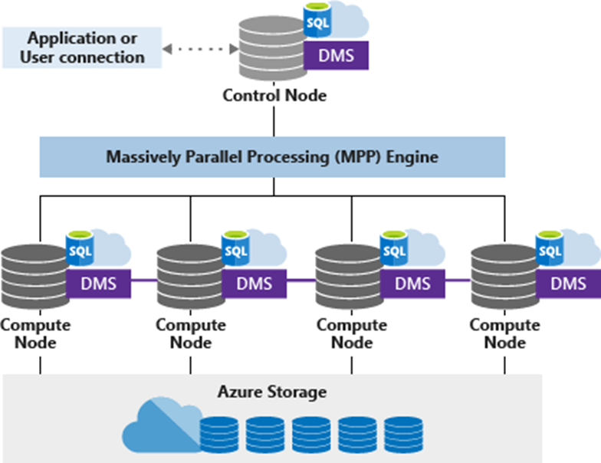
Architecture of Azure SQL DW

Slide 29
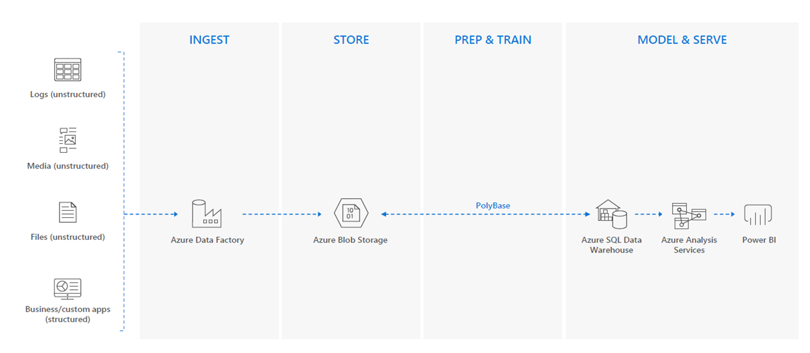
Cloud Data Warehouse

Slide 30
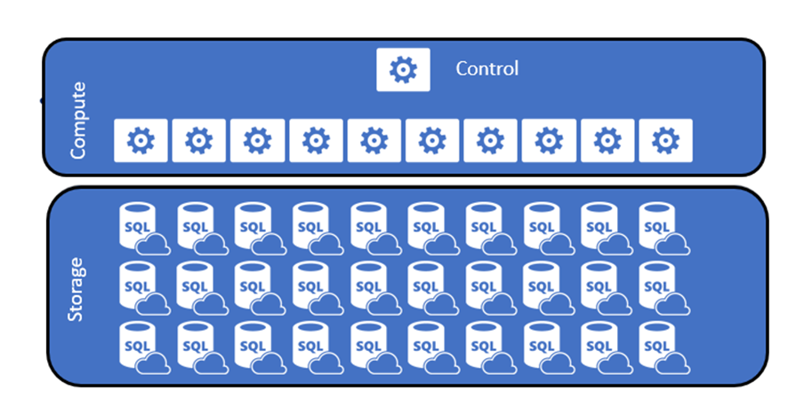
Logical Overview

Slide 31
Distributions
SQL Data Warehouse stores one or more distributed table
Splits data table to 60 buckets through compute nodes
There are two types of distributions:
Hash distributed table
Round-Robin distributed table

Slide 32
Hash Distributed
Data divided across nodes based on hashing algorithm
Same value will always hash to same distribution
Optimal for large fact tables
Data Skew can be an issue when distributing on high frequency values

Slide 33
Round-Robin Distributed
Data distributed evenly across nodes
Easy place to start, don’t need to know anything about the data
Useful for dimension tables and tables without a good hash column
Will incur more data movement at query time

Slide 34
Data Warehouse Units (DWUs)
DWUs are measured of resources like CPU, Memory and IOPS, which are allocated to Azure SQL DW instance
DWUs decide how many compute nodes the instance uses, concurrent queries the instance can run and parallel readers can read data

Slide 35
Hit Refresh – Azure Data Factory
Access and ingest data with built-in connectors without data loss

Slide 36
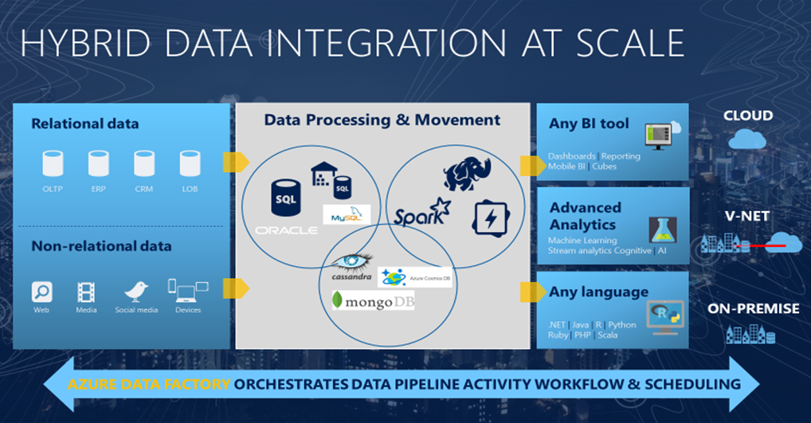
Azure Data Factory

Slide 37

How does it work?

Slide 38
Top-level concepts
Pipeline
Activity
Datasets
Triggers

Slide 39
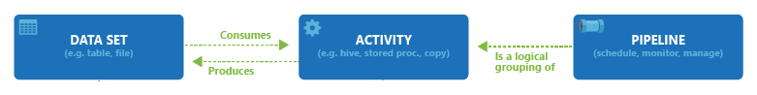
Pipelines and activities
A pipeline is a logical grouping of activities
Pipeline allows you to manage the activities as a set
The activities in a pipeline define actions to perform on data

Slide 40
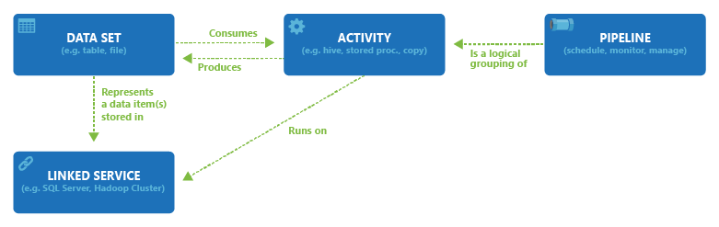
Linked services
Linked service is to link data store to the data factory
Linked services are much like connection strings

Slide 41
Datasets
A dataset is a named view of data
Datasets identify data within different data stores, such as tables, files, folders, and documents

Slide 42
Trigger
Triggers are another way that you can execute a pipeline run
Triggers represent a unit of processing that determines when a pipeline execution needs to be kicked off
Data Factory supports three types of triggers:
Schedule trigger
Tumbling window trigger
Event-based trigger

Slide 43
Pricing
Data pipelines
Integrate data from cloud and hybrid data sources, at scale.
Pricing starts from ₹66.10 /1,000 activity runs per month
SQL Server Integration Services
Easily move existing on-premises SQL Server Integration Services projects to a fully-managed environment in the cloud.
Pricing for SQL Server Integration Services integration runtime nodes start from ₹55.51 /hour

Slide 44
Hit Refresh - Storage
Highly scalable cloud storage with built-in security, durability & reliability

Slide 45
Cloud Application Requirements
Durable and highly available
Scalable and performant
Multiple concurrent users
Secure
Manageable
Time to market

Slide 46
Introducing Microsoft Azure Storage
Cloud Storage - Anywhere and anytime access
Blobs, Disks, Tables, Queues and Files
Highly Durable, Available and Massively Scalable
Easily build “Internet scale” applications
More than 35 trillion stored objects
3.5+ Million requests/sec on average
Pay only for what you use
Exposed via easy and open REST APIs
Rich Client Libraries and Tools

Slide 47
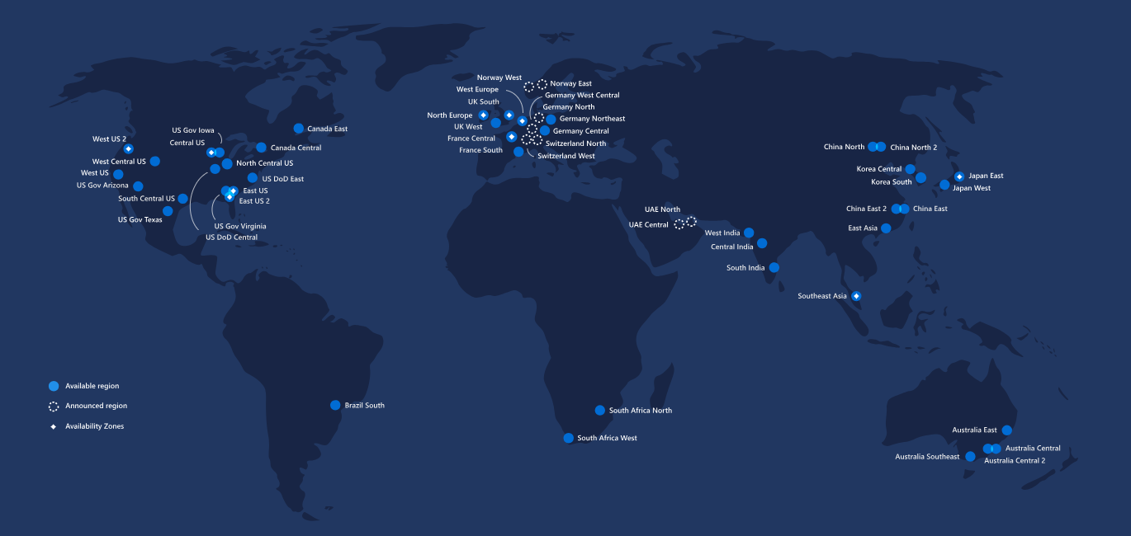
54 Regions Worldwide in 2019

Slide 48
Azure Storage Components:
Blobs – Highly scalable, REST based cloud object store
Tables – Massive auto-scaling, NoSQL store
Queues – Reliable messaging at scale for cloud services
Disks – Persistent Premium & Standard disks for Azure IaaS VMs
Files – SMB 3.0 access to Azure Storage
Azure Import/Export – Ship data in HDD
AZCopy – High-performance data upload , download, & copy

Slide 49
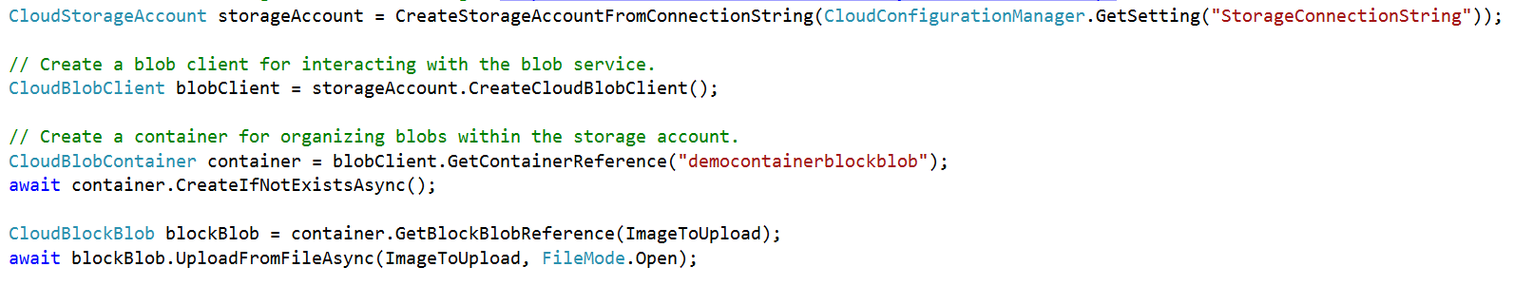
Abstractions – Blobs
Blobs – Massively scalable object store in the cloud
Simple REST interface (Put, Get, Delete)
Data sharing – share documents, pictures, video, music, etc.
Big Data – store raw data/logs and compute/map reduce over data
Backups – data and device backups

Slide 50
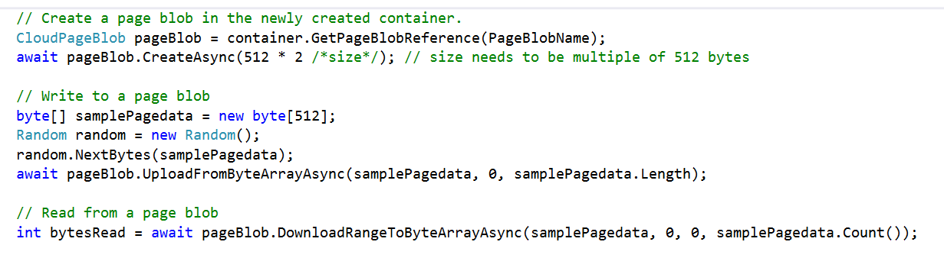
Abstractions – Disks
Persistent disks for VMs in Azure
Disks are VHDs stored in Azure Page Blobs
Page blobs are optimized for random I/O
VM see the VHD/Blob as a disk
Reads translated to GETs, writes to PUTs
Blob protected by write-lease
Reads from the blob (and snapshots) still allowed

Slide 51
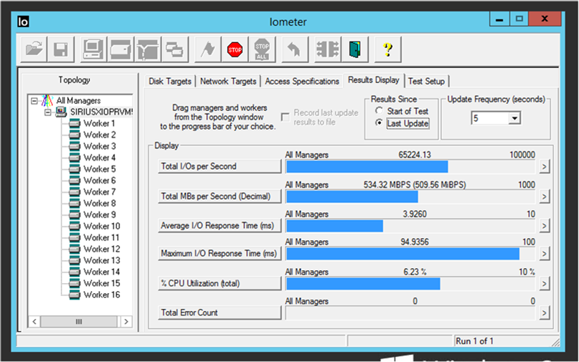
Premium Storage
Consistent low latency SSD based with predictable IO throughput
Suitable for high-performance IO-intensive database workloads
Single digit milliseconds latencies
Supports up to 1 TB blob/disk size
Stripe up to 32 disks for a total of
32TB and more than 50,000 IOPS
Premium Storage Disks work in
conjunction with a new VM series

Slide 52
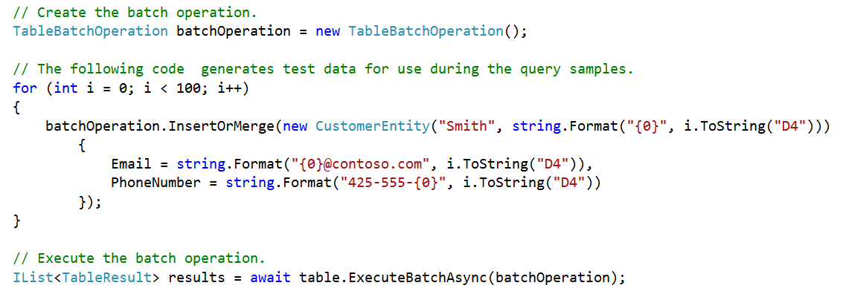
Abstractions – Tables
Tables – Massively scalable NoSQL cloud store
Key/Attribute(s) store at scale
Store user, device or any type of metadata for your service
Auto load balances partitions to meet traffic needs
OData protocol (AtomPub or JSON)

Slide 53
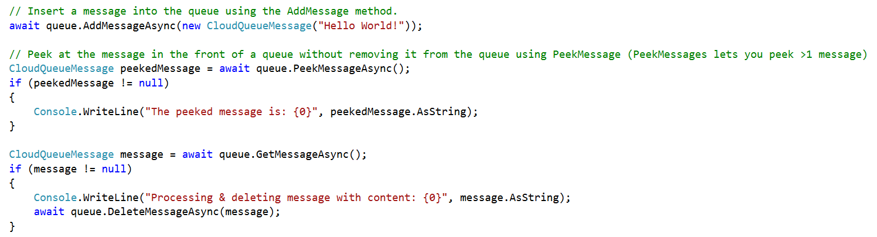
Abstractions – Queues
Queues – Reliable messaging system
Reliable, low latency, high throughput messaging system
Decouple components/roles
Web role to worker role communication
Allows roles to scale independently
Implement scheduling of asynchronous tasks
Building process/work flows

Slide 54
Abstractions – Files
Move on-premises applications to cloud
VMs can net use an SMB share using standard file APIs and semantics
SMB 2.1 protocol
VM and storage account within same region
Supports REST and SMB protocol access to same file share
Microsoft Azure
Share data stored in Azure Files among Azure VMs via SMB
Azure Storage
SMB
Blobs
Tables
REST API
Queues
REST API
Files

Slide 55
Azure Storage Architecture
Import / Export
Client Libraries
(.NET, Java, c++, Android, Node.JS…)
SMB Client
REST
REST
REST
REST
SMB 2.1
Blob/Disk
Endpoint
Table
Endpoint
Queue
Endpoint
File Share
Endpoint
Front End Layer
Massive Scale Out & Auto Load Balancing Index Layer
Partition Layer
Distributed Replication Layer
Stream Layer

Slide 56
Durability Options
Locally Redundant Storage (LRS)
Stores 3 replicas of the data within a single zone (facility) in a single region
Provides data durability for disk, node and rack failures
Geo Redundant Storage (GRS)
Stores 6 replicas of the data across two regions (3 in each region)
Provides additional durability to protect data against major regional natural disasters (e.g., tornado, hurricane, fire, etc, destroying a whole region)
Updates across regions are performed asynchronously
Zone Redundant Storage (ZRS)
Stores 3 replicas of the data across multiple zones (facilities) within a single region or across regions
Provides additional durability to protect data against zone failures (e.g., fire burning down a facility)

Slide 57
Secondary Read-Only Access
Customers using Geo Redundant Storage can opt to have read-only access to the eventually consistent copy of the data on Secondary tenant
Applications control which location they read data from
Primary endpoint
accountname.<service>.core.windows.net
Secondary endpoint
accountname-secondary.<service>.core.windows.net
Consistency
All Writes go to the Primary
Reads to Primary are Strongly Consistent
Reads to Secondary are Eventually Consistent
Our client library SDK provides features for reading from the secondary
Retry options: PrimaryOnly, SecondaryOnly, PrimaryThenSecondary, etc.

Slide 58
Access Control
Symmetric Shared Key AuthN
Trusted service that owns the storage accounts
Shared Access Signature (SAS) Delegated AuthZ
3rd party services
Mobile device applications
Restricted access for services
Allow client applications to directly communicate with Storage rather than scaling a proxy web service
Public (Blob service only)
CDN access
Browser based access

Slide 59
Hit Refresh – Event Hubs
Ingest millions of events per second

Slide 60
Event Hubs
A Big Data streaming platform and event ingestion service
Can receive and process millions of events per second
Processes and store events, data, or telemetry produced by distributed software and devices

Slide 61
Scenarios to use Event Hub
Anomaly detection (fraud/outliers)
Application logging
Analytics pipelines, such as clickstreams
Live dashboarding
Archiving data
Transaction processing
User telemetry processing
Device telemetry streaming

Slide 62
Why use Event Hubs?
Fully managed PaaS
Support for real-time and batch processing
Scalable
Rich ecosystem

Slide 63

Key architecture components

Slide 64
Features and terminology in Azure Event Hubs
Namespace
Event Hubs for Apache Kafka
Event publishers
Capture
Partitions
Stream offsets

Slide 65
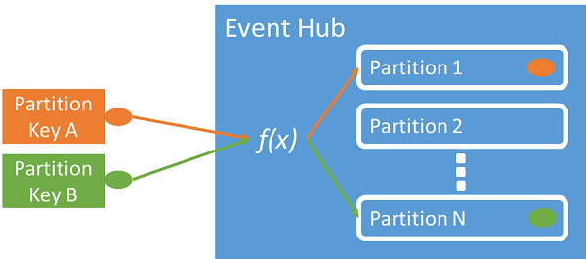
Event Publishers
Sends data to an event hub
Can publish events using HTTPS or AMQP 1.0 or Kafka 1.0 and later

Slide 66
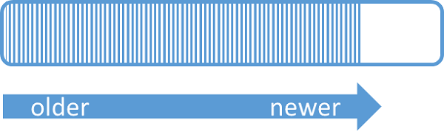
Partitions
A partitioned consumer pattern
Enables horizontal scale for event processing
A partition is an ordered sequence of events

Slide 67

Stream Offsets
An offset is the position of an event within a partition
Offset enables an event consumer to specify a point in the event stream
Consumers are responsible for storing their own offset values

Slide 68
Azure Event Hubs Capture
Event Hubs Capture helps to event data
Captured data can be stored in Azure Storage Account
Sored data can be fed as input to

Slide 69
Pricing
 | BASIC | STANDARD | DEDICATED*
Ingress events | ₹1.86 per million events | ₹1.86 per million events | Included
Throughput unit (1 Mb/s ingress, 2 Mb/s egress) | ₹1.00/hour | ₹1.99/hour | Included
Message size | 256 KB | 256 KB | 1 MB
Consumer groups | 1 – Default | 20 | 20
Message replay | Available | Available | Available
Maximum throughput units | 20 | 20** | 1 CU≈50
Apache Kafka | Not available | Available | Available
Brokered connections | 100 included | 1,000 included | 25K included
Message retention | 1 day included | 1 day included*** | Up to 7 days included***
Additional brokered connections | Not available | Available | Available
Publisher policies | Not available | Available | Available
Capture | Not available | ₹6.61/hour | Included

Slide 70
Hit Refresh – Stream Analytics
Analyse data from all the gateways and IoT devices

Slide 71
Introducing Stream Analytics
An event-processing engine that allows you to examine high volumes of data streaming from devices
Incoming data can be from devices, sensors, web sites and more
supports extracting information from data streams, identifying patterns, and relationships

Slide 72
Stream Analytics Examples
Internet of Things(IoT) Sensor fusion and real-time analytics on device telemetry
Web logs/clickstream analytics
Geospatial analytics for fleet management and driverless vehicles
Remote monitoring and predictive maintenance of hi-value assets
Real-time analytics on Point of Sale data for inventory control and anomaly detection

Slide 73
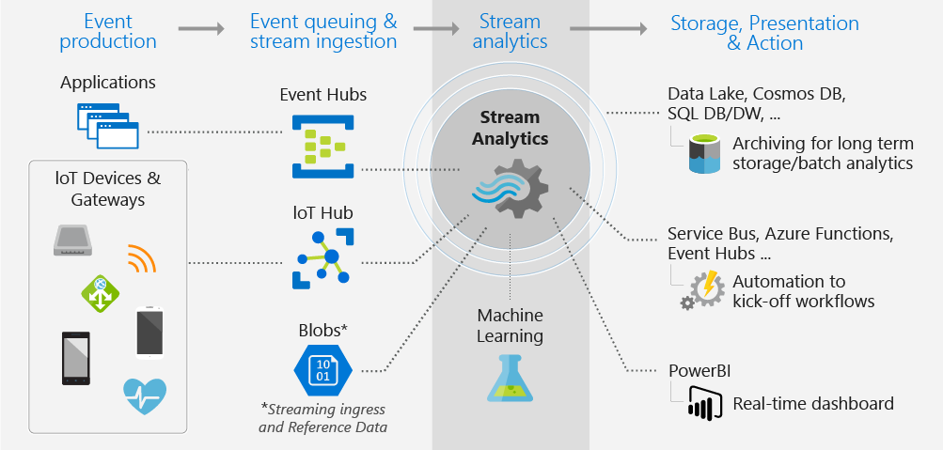
Working of Stream Analytics

Slide 74
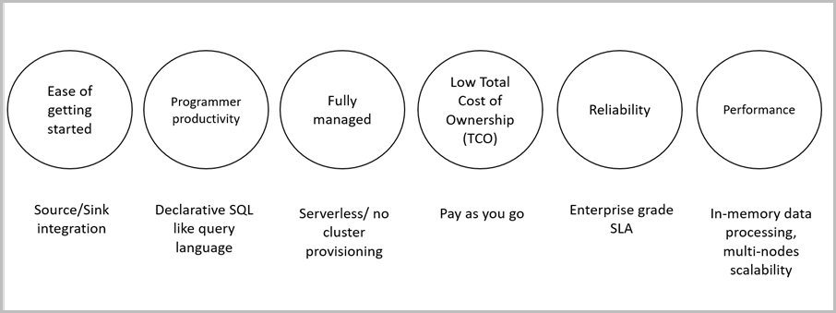
Key Capabilities and Benefits

Slide 75
Input integrations to Stream Analytics
Azure Event Hubs
Azure IoT Hub
Azure Blob Storage

Slide 76
Streaming Jobs
Set of activities triggered in the service
Can be triggered on the timely basis or on the event basis
Activities can be tracked using Job diagram

Slide 77
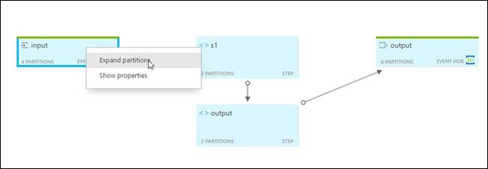
Job Diagram

Slide 78
Hit Refresh – HDInsight
Use HDInsight tools to easily get started in your favourite development environment

Slide 79
Azure HDInsight and Apache Hadoop
Apache Hadoop was the original open-source framework for distributed processing and analysis of big data sets on clusters
Hadoop technology stack includes related software and utilities, including Apache Hive, Apache HBase, Spark, Kafka, and many others
Azure HDInsight is a cloud distribution of the Hadoop components from the Hortonworks Data Platform (HDP)

Slide 80
Apache Hadoop architecture in HDInsight
Apache Hadoop includes two core components:
Apache Hadoop Distributed File System (HDFS)that provides storage
Apache Hadoop Yet Another Resource Negotiator (YARN) that provides processing

Slide 81
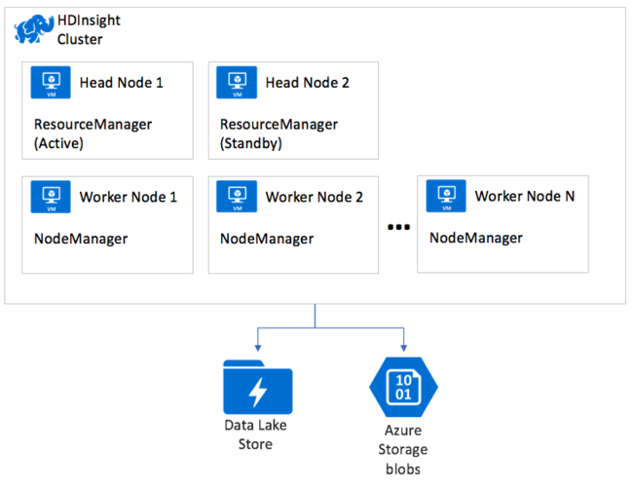
YARN on HDInsight

Slide 82
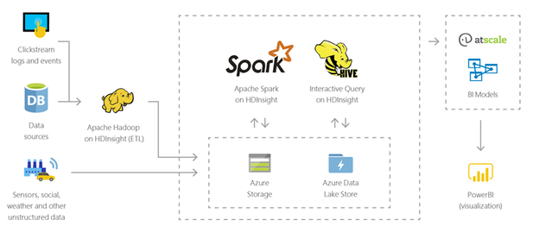
Data warehousing using HDInsight

Slide 83
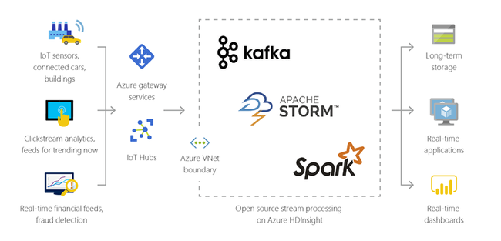
Internet of Things with HDInsights

Slide 84
Hit Refresh – Azure Data Bricks
A fast, easy and collaborative Apache Spark based analytics platform optimized for Azure

Slide 85
Azure Databricks
Designed in collaboration with the founders of Apache Spark
One-click set up and streamlined workflows
Interactive workspace that enables collaboration between data scientists, data engineers, and business analysts.
Native integration with Azure services
Enterprise-grade Azure security

Slide 86
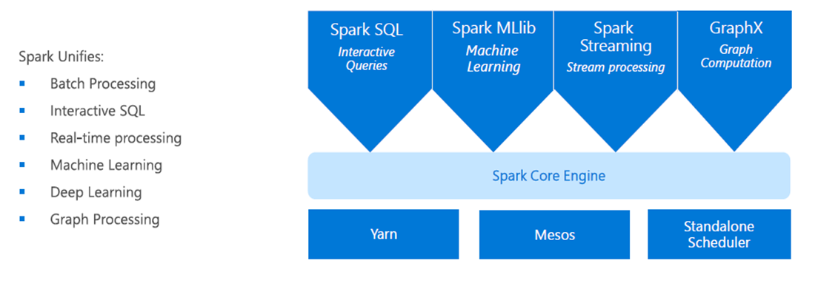
Apache Spark

Slide 87
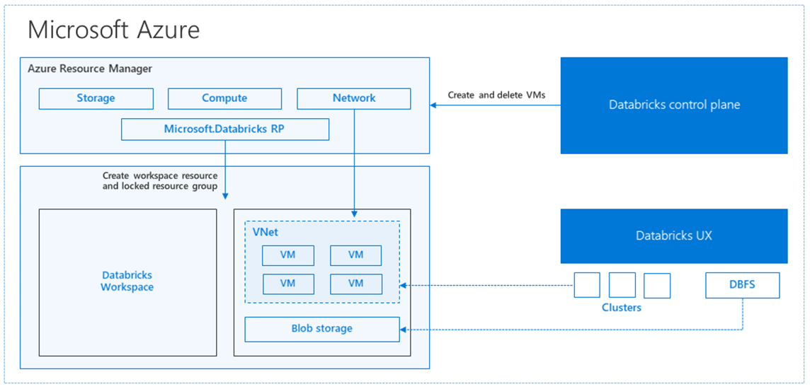
Data Bricks Architectural View

Slide 88
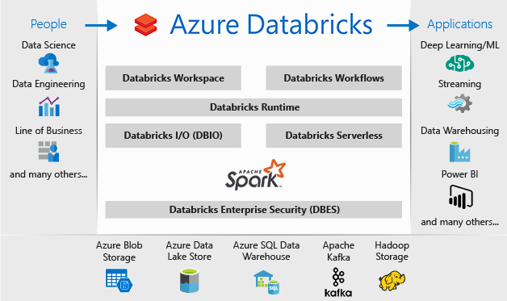
Azure Data Bricks with Azure Services

Slide 89
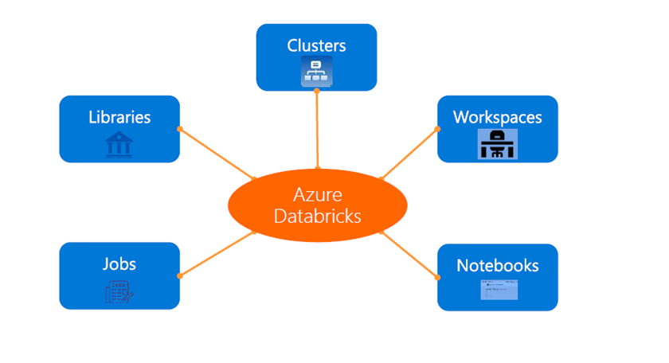
Azure Databricks Core Artifacts

Slide 90
Clusters : Auto-scaling and Auto-termination
Simplifies cluster management and reduces costs
Autoscaling and Auto Termination options can be chosen while creating clusters
Autoscaling helps Azure Databricks to automatically scales up or down based on load
After specified minutes of inactivity the cluster will automatically terminate using Auto Terminate

Slide 91
Jobs
Jobs are the mechanism to submit Spark application code for execution on the Databricks clusters
Spark application code is submitted as a ‘Job’ for execution on Azure Databricks clusters
Jobs execute either ‘Notebooks’ or ‘Jars’
Azure Databricks provide a comprehensive set of graphical tools to create, manage and monitor Jobs.

Slide 92
Workspaces
Workspaces enables users to organize and share Notebooks, Libraries and Dashboards
Everything in a workspace is ordered into hierarchical folders
Fine grained access controls can be defined in workspaces to enable secure collaboration among colleagues

Slide 93
Notebooks
Notebooks are not only for authoring Spark applications but can be run/executed directly on clusters
Notebooks support fine grained permissions—so they can be securely shared with colleagues for collaboration
Notebooks are well-suited for prototyping, rapid development, exploration, discovery and iterative development

Slide 94
Visualization
All notebooks, regardless of their language, support Databricks visualizations.
While running the notebook. visualizations are rendered inside the notebook in-place
The visualizations are written in HTML
You can save the HTML of the entire notebook by exporting to HTML

Slide 95
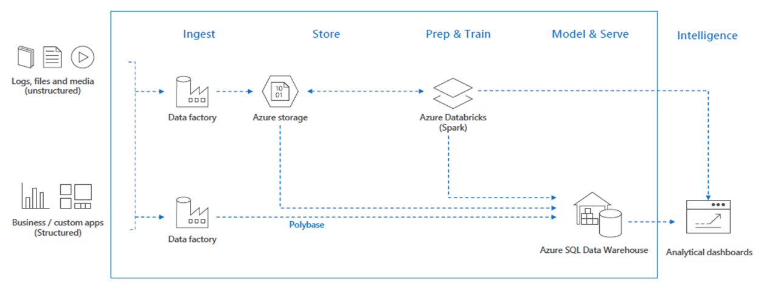
Use cases – Modern Big Data Warehouse

Slide 96
Hit Refresh – Azure Cosmos DB
A database for building blazing fast, planet scale applications with native support for NoSQL

Slide 97
Apache Hadoop architecture in HDInsight
Built from the ground up with global distribution and horizontal scale
Offers turn-key global distribution across any number of Azure regions
Transparently scales and replicates data wherever the users are

Slide 98
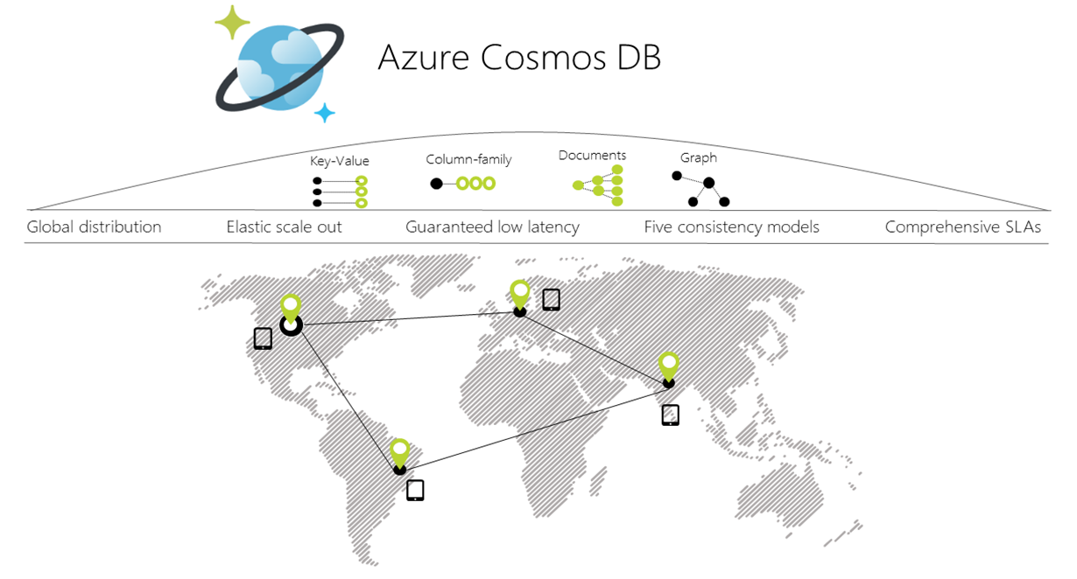
Global Scale of Azure Cosmos DB

Slide 99
Global Distribution
Easily build globally-distributed applications
Designed as a globally distributed database system
Automatically replicates all data to any number of regions
Supports transparent multi-homing and guarantees 99.99% high availability

Slide 100
Multi-model + multi-API
Cosmos DB allows to use key-value, graph, and document data in one service without worrying about schema or index management
Automatically indexes all data
Use favourite NoSQL API including SQL, JavaScript, Gremlin, MongoDB, and Azure Table storage to query data

Slide 101
Elastic scale out of storage and throughput
Only pay for the throughput and storage you need
Independently and elastically scale storage and throughput across one or multiple global regions.

Slide 102
Choice of Consistency
Offers five well-defined consistency levels:
Strong
Bounded staleness
Session
Consistent-prefix
Eventual

Slide 103
Guaranteed Single-Digit Millisecond Latency
Serve read and write requests from the nearest region while simultaneously distributing data across the globe
Less than 10-ms latencies on reads writes at the 99th percentile
Less than 15-ms latencies on (indexed) writes at the 99th percentile

Slide 104
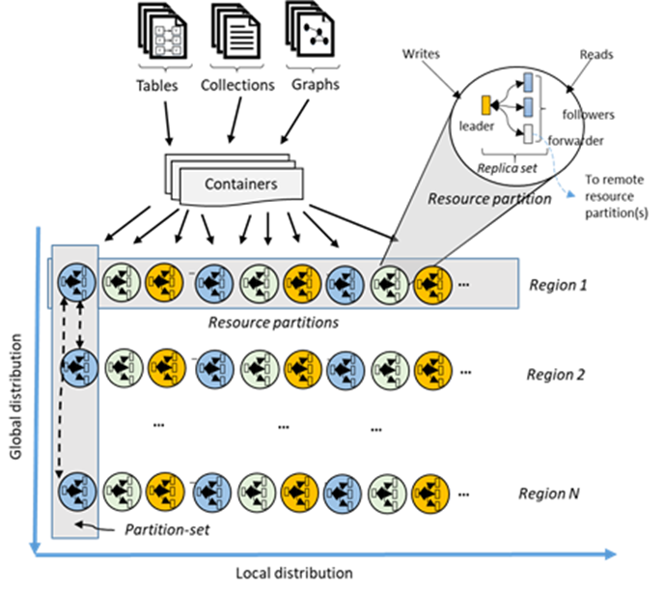
Data Distribution

Slide 105
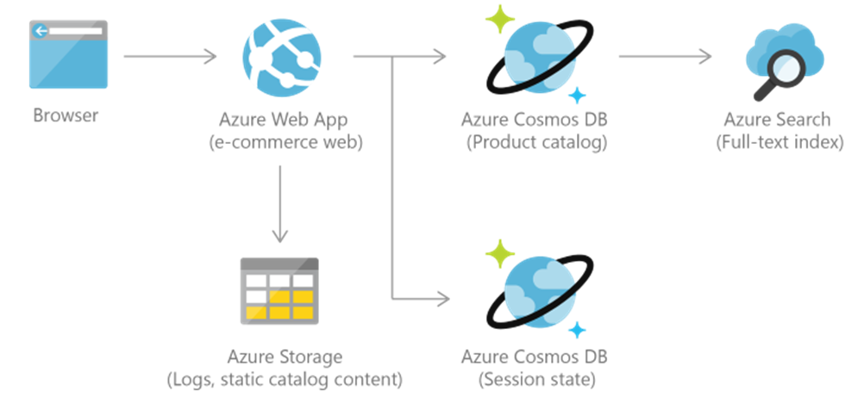
Retail and Marketing using Cosmos DB

Slide 106
Questions

